Slide 1


CMR TECHNICAL CAMPUS
UGC AUTONOMOUS
Accredited by NBA & NAAC with ‘A’ Grade
Approved by AICTE,New Delhi and affiliated to JNTU,Hyderabad Kandlakoya (V), Medchal Road, Hyderabad -501401,Telangana
Department of Computer Science and Engineering
Mini Project Final Review
5G-SMART DIABETES : TOWARDS PERSONALIZED DIABETES DIAGNOSIS WITH HEALTHCARE BIG DATA CLOUDS
BATCH NO-08
UNDER THE GUIDANCE OF: PRESENTED BY:
Dr.K.MAHESWARI B.DEEKSHITHA : 207R1A05K1
(Associate Professor) L.GAYATHRI : 207R1A05L9
E.JAYANTH GOUD: 207R1A05K9

Slide 2
Contents :
Abstract
Existing system
Disadvantages of Existing system
Proposed system
Advantages of Proposed system
Hardware and Software requirements
Novelty of the Project
Architecture
Modules
UML Diagrams
Sample Code
Results
Conclusion
Future Scope
References
Github Link

Slide 3
Abstract:
In this project we are using today’s 5G technology to monitor condition of diabetic patients with low cost.
Diabetes will be of two type’s diabetes-1 and diabetes-2. Diabetes-2 require hospitalization and in diabetes-1 condition we can monitor patient and alert him or doctors about his current condition.
Keywords:5G-smart diabetes, ensemble classifier, diabetes 2

Slide 4
Existing system:
The system works by integrating data from various sources such as patient medical records, wearables, sensors, and other healthcare devices.
The data is then transmitted through 5G networks to cloud-based platforms, where it is analyzed using big data analytics tools to provide personalized diabetes diagnosis and treatment plans.
The use of 5G networks ensures fast and reliable transmission of data, which is essential in real-time monitoring and management of diabetes.

Slide 5
Disadvantages of Existing system:
Cost: Implementing this system can be expensive.
Privacy and security concerns: As with any system that involves the collection and analysis of sensitive health data, the potential for misuse of patient information can erode patient trust and confidence in the system.
Limited personal interaction: The reliance on technology and remote monitoring may reduce opportunities for personal interaction.
Data accuracy and reliability: There is always a risk of inaccuracies or errors in the data. Factors such as data quality, missing data.
Access and connectivity: Not all patients or healthcare providers may have access to the high-speed 5G networks and smart devices needed to participate in this system.

Slide 6
Proposed system:
In proposed work, we are using Decision Tree, SVM, Artificial Neural Network algorithms from python to predict patient condition from his data.
To train these algorithms we are using diabetes dataset.
To predict data efficiently author is using Ensemble Algorithm which is combination of Decision Tree, SVM and ANN algorithm.
Training model of all these three algorithms will be merging inside Ensemble Algorithm to get better accuracy and prediction.

Slide 7

Advantages of Proposed System:
Preventing many of the type2 diabetic cases.
Improved accuracy and efficiency.
Tailored treatment plans.
Continuous monitoring.
Improved privacy and security.
Remote monitoring and care.

Slide 8
Software requirements:
Operating system : Windows 10
Coding Languages : Python 3.7
Front End : HTML , Bootstrap
Backend : Django
User interfaces : Mobile apps, web portals, and dashboards

Slide 9
Hardware Requirements:
System : I3 Processor
Hard disk : 300 GB
Ram : 8 GB
Smart diabetes devices : continuous glucose monitors (CGMs),Insulin pumps, sensors for monitoring glucose levels.
Healthcare big data cloud : servers, storage devices, and networking infrastructure.

Slide 10
Novelty of the project:
The combination of 5G technology, smart diabetes devices, and healthcare big data clouds has the potential to revolutionize diabetes care by enabling personalized and data-driven management. Here are some key aspects of its novelty:
Improve patient outcome : By providing personalized and data –driven care,5g smart diabetes has the potential to improve patient outcomes and quality of life.
Improving Accuracy : By combining the multiple machine learning algorithms, the overall accuracy will be improved.
Personalized Diagnosis and Treatment : The ability to analyze large amount of patient data can enable healthcare providers to provide personalized diabetes diagnosis and treatment plans.

Slide 11
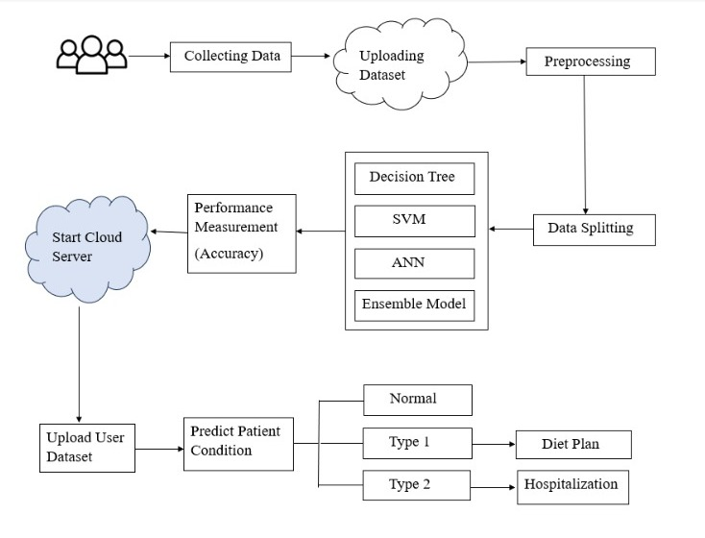
Architecture:

Slide 12
Modules:
Sensor and Device Module
Data Collection and Transmission Module
Healthcare Big Data Module
Personalized Diabetes Diagnosis Module
Cloud Infrastructure Module
User Interface and Mobile Application Module

Slide 13
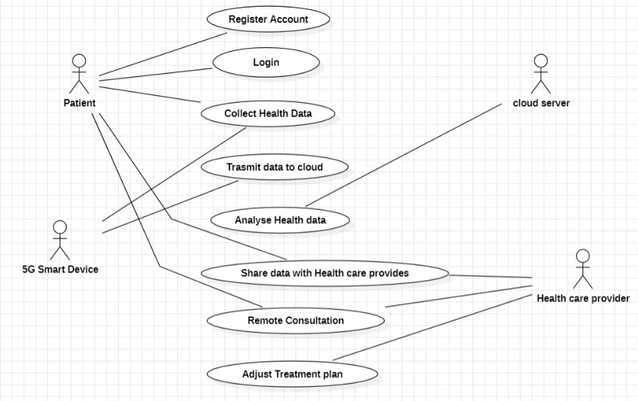
UML Diagrams:
USE CASE DIAGRAM:

Slide 14
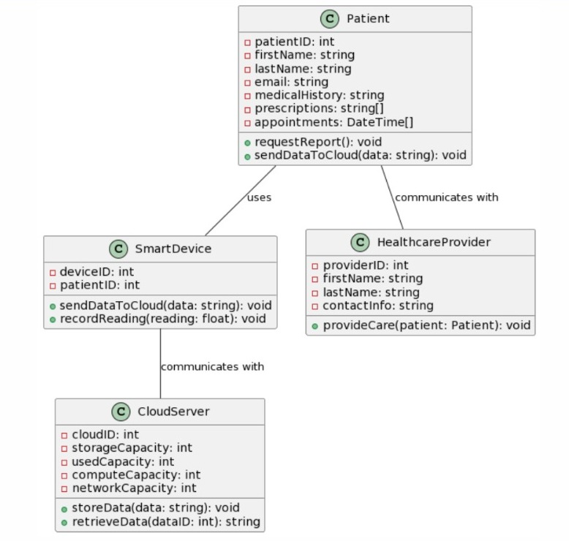
CLASS DIAGRAM:

Slide 15
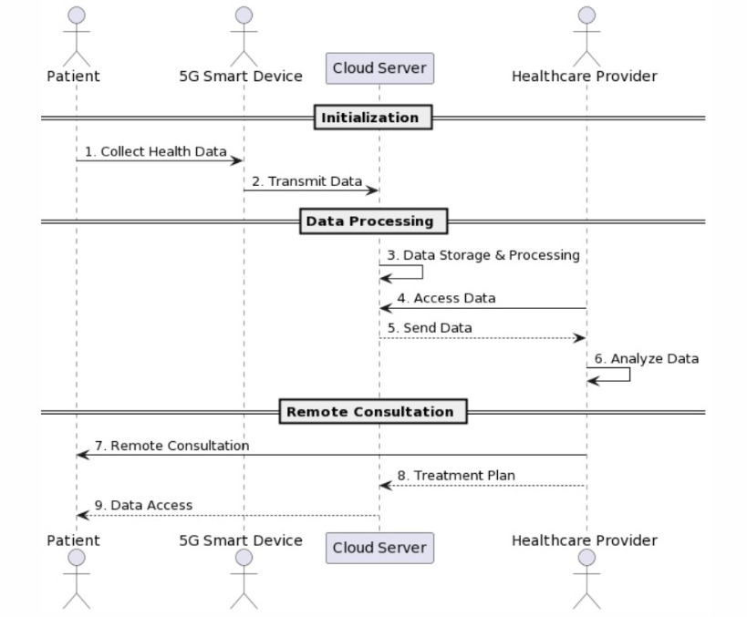
SEQUENCE DIAGRAM:

Slide 16
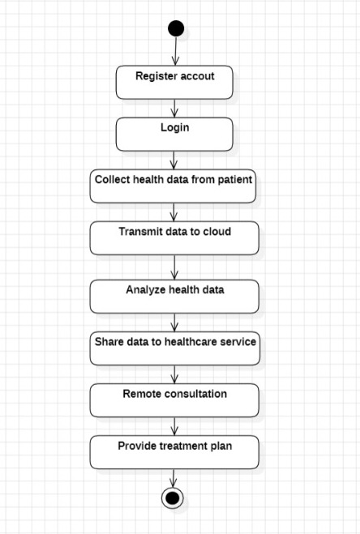
ACTIVITY DIAGRAM:

Slide 17
Sample Code:
import pandas as pd
import numpy as np
import matplotlib.pyplot as plt
from tkinter import messagebox
from tkinter import *
from tkinter.filedialog import askopenfilename
from tkinter import simpledialog
import tkinter
from tkinter import filedialog
import os
from sklearn.model_selection import train_test_split
from sklearn import metrics
from sklearn.tree import DecisionTreeClassifier
from sklearn.metrics import accuracy_score
from sklearn import svm

Slide 18
def decisionTree():
global decision
global decision_acc
decision = DecisionTreeClassifier()
decision.fit(X_train,y_train)
y_pred = decision.predict(X_test)
decision_acc = accuracy_score(y_test,y_pred)*100
def runSVM():
global svm
global svm_acc
svm = svm.SVC(C=2.0,gamma='scale',kernel = 'rbf', random_state = 2)
svm.fit(X_train, y_train)
y_pred = svm.predict(X_test)
svm_acc = accuracy_score(y_test,y_pred)*100
text.insert(END,"SVM Accuracy : "+str(svm_acc)+"\n")

Slide 19
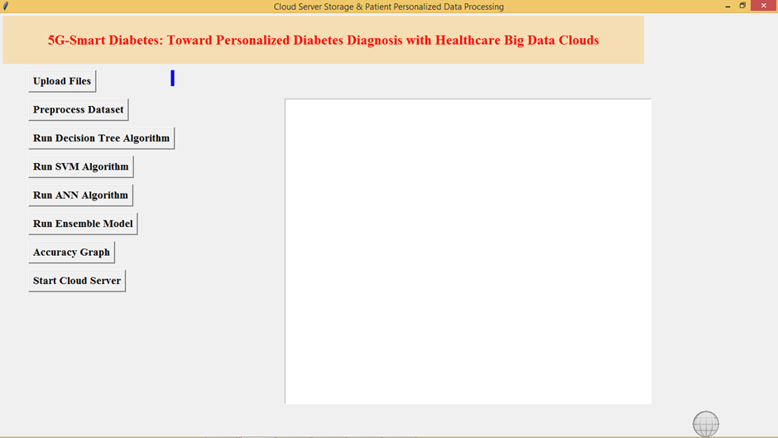
Results:
In above screen click on ‘Upload Files’ button to upload diabetes dataset

Slide 20
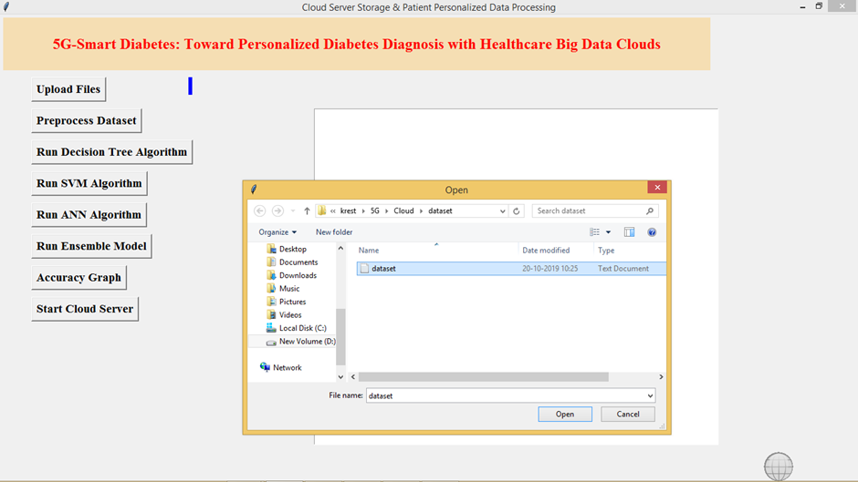

Slide 21
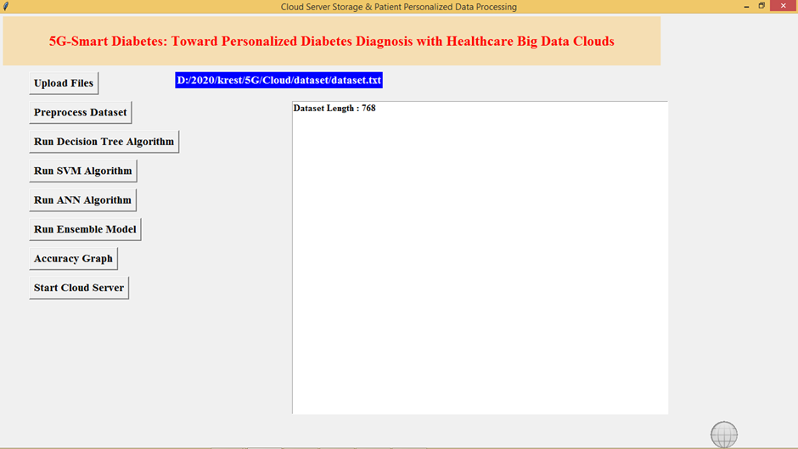

Slide 22
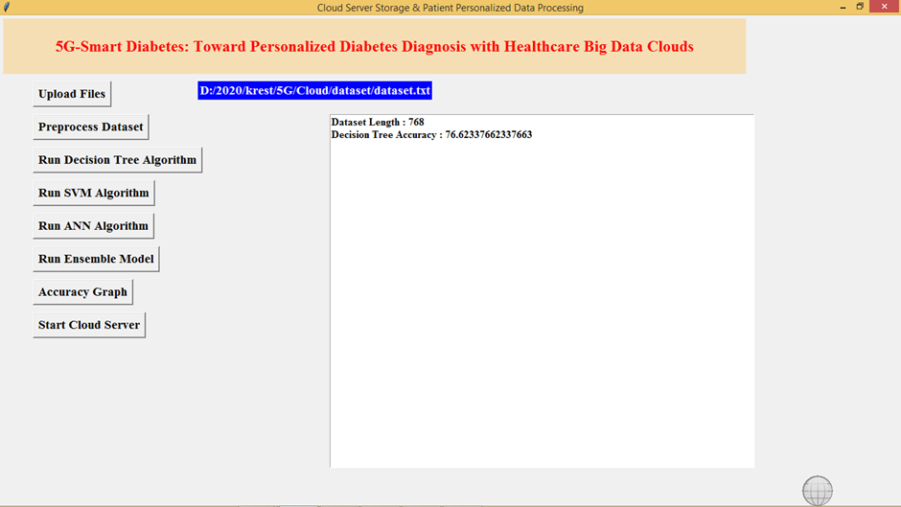

Slide 23
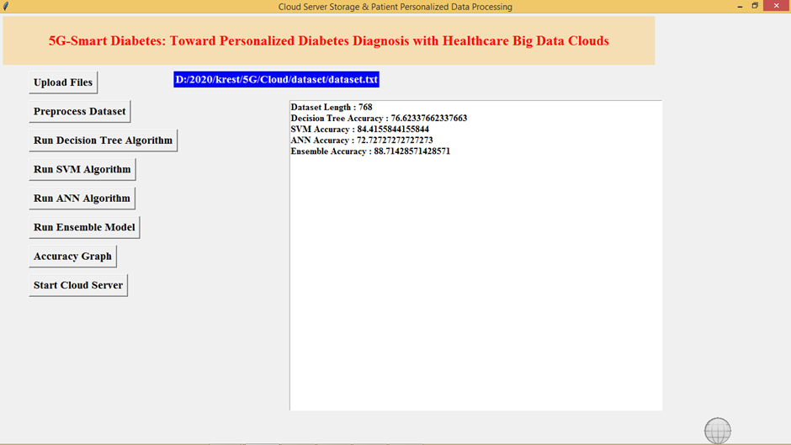

Slide 24
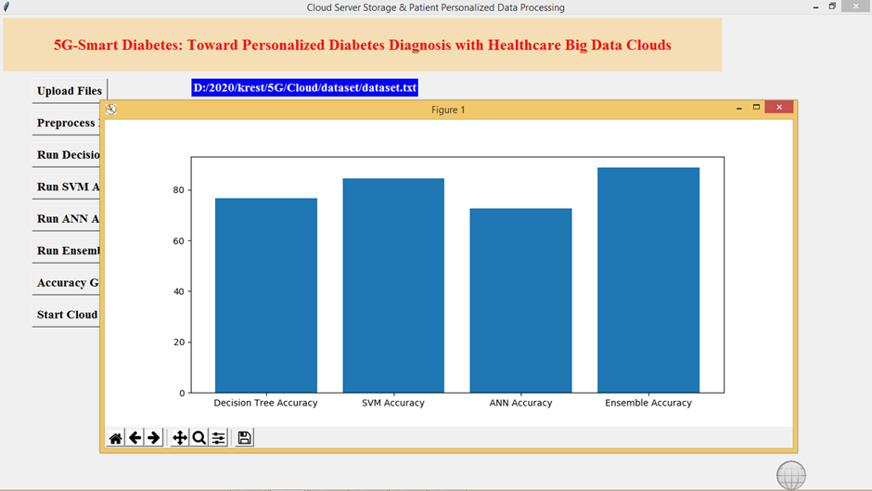

Slide 25
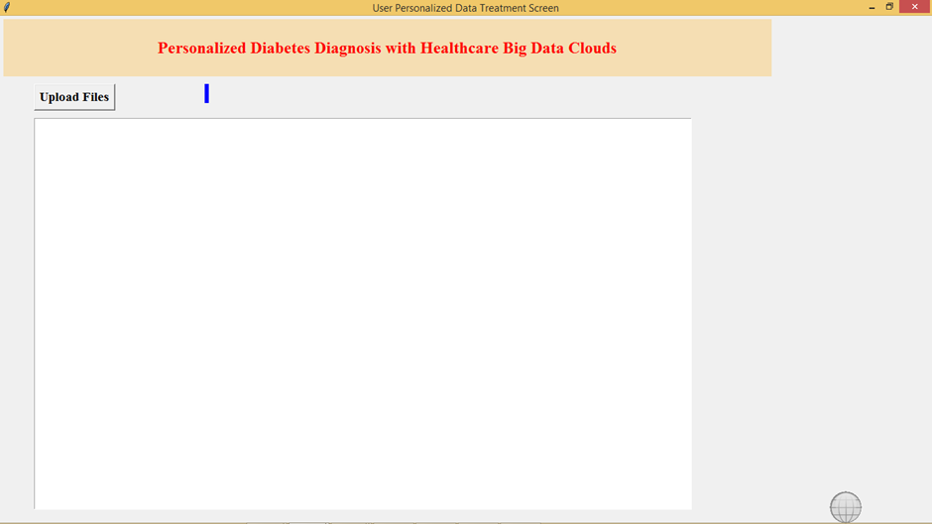

Slide 26
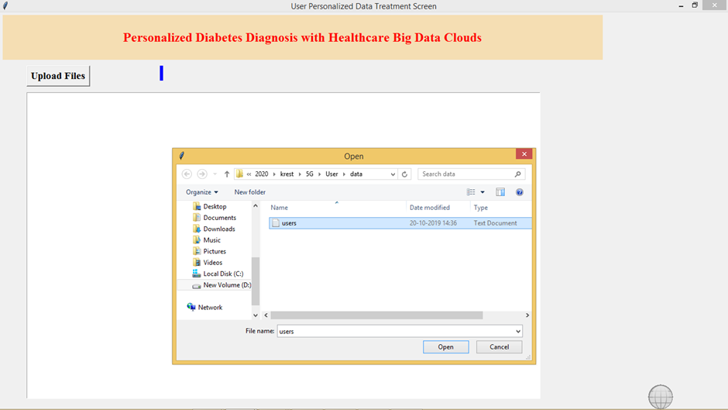

Slide 27
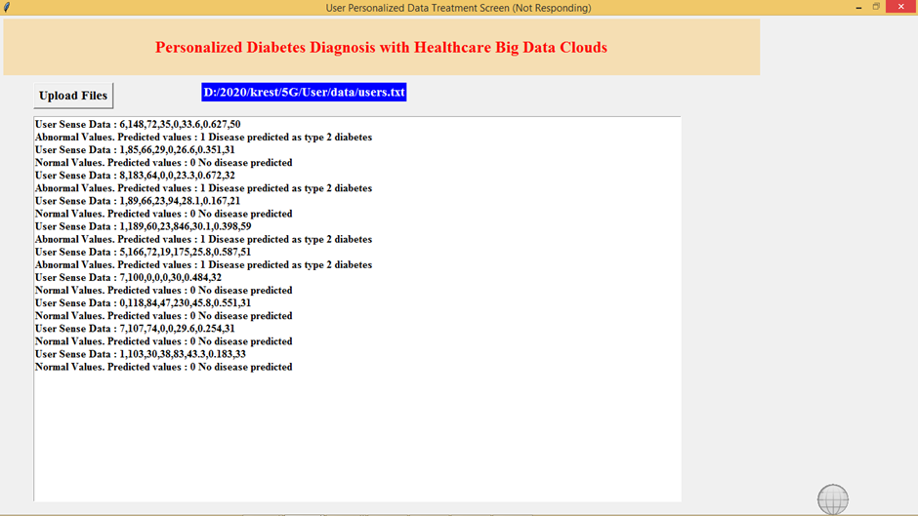

Slide 28
Conclusion:
The integration of 5G technology and smart diabetes monitoring has the potential to revolutionize personalized diabetes diagnosis and treatment. With the help of 5G networks, patient data from wearable devices and medical sensors can be transmitted in real-time to healthcare providers, allowing for more accurate and timely diagnosis and treatment.
Overall, the combination of 5G technology, smart diabetes monitoring, and healthcare big data clouds holds great promise for improving diabetes care and outcomes.

Slide 29
Future Scope:
This work extended with an intelligent architecture for monitoring diabetic patients by using machine learning algorithms.
The architecture elements included smart devices, sensors, and smartphones to collect measurements from the body. The intelligent system collected the data received from the patient and performed data classification using machine learning in order to make a diagnosis.
The proposed prediction system was evaluated by several machine learning algorithms, and the simulation results demonstrated that the ensemble model gives superior classification accuracy, sensitivity, and precision compared to other algorithms.

Slide 30
References:
S. Mendis, “Global Status Report on Noncommunicable Diseases 2014,” WHO, tech. rep.; http://www.who.int/ nmh/publications/ncd-status-report-2014/en/, accessed Jan. 2015.
Venkatachalam, K., Prabu, P., Alluhaidan, A.S. et al. Deep Belief Neural Network for 5G Diabetes Monitoring in Big Data on Edge IoT. Mobile Network April 27, 1060–1069 (2022). https://doi.org/10.1007/s11036-021-01861-y.
E P, Prakash et al. “Implementation of Artificial Neural Network to Predict Diabetes with High-Quality Health System.” Computational intelligence and neuroscience vol. 2022 1174173. 30 May. 2022, doi:10.1155/2022/1174173.

Slide 31
Github Link:
https://github.com/Ladesani18/5G-Smart-Diabetes-Toward-personalized-diabetes-diagnosis-with-healthcare-big-data-clouds-207R1A05L9

Slide 32

.
.

